Slide 1
An Introduction to DevOps
Based on the article “Adopting DevOps Practices in Quality Assurance” by James Roche
By: Dominic Bembry, Zach Sublett

Slide 2
What is DevOps?
Development and operations workers, often shorten to DevOps, is the name given to the combination of a developer’s and operations’ job into one responsibility.
People who occupy this role, or companies that follow its principles, now work a lot closer with quality assurance people (QA) in defining and solving risk and maintainability issues.

Slide 3
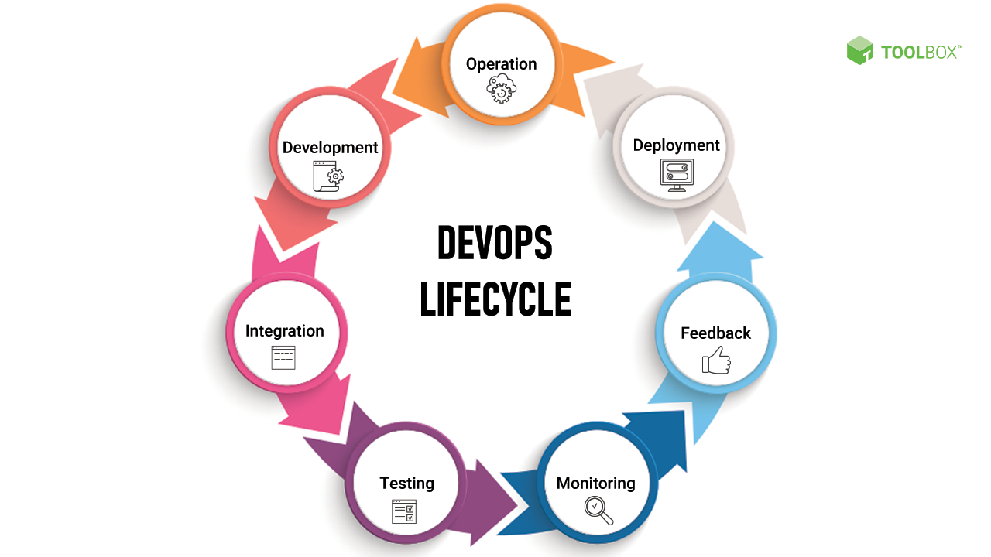
Notes:
This is the DevOps lifecycle. As you can see, it is very reminiscent of the Agile Methodology approach to software development due to its cyclic nature. I believe it is a very important pattern to recognize since this was one of the first large movements in the early 21st century to push towards a more agile work environment.

Slide 4
Why Did Devops Come About?
In earlier product life cycles, companies followed the Waterfall model of development that had very predictable and sequential order of operations.
But as the world entered the new millennium, companies began to expect many of these professionals to be more fluid in their responsibilities and knowledge.
Notes:
Developers would design and build the product, then QA professionals would find and predict where bugs would arise, and finally handed it off to operations to maintain the product during its release.
These positions would be relatively separate, and once one finished their work it was often out of their hands.
No longer will developers, QAs, and operations professionals’ work be disjoint, but rather there now exists major overlap in responsibilities among these roles.

Slide 5
DevOps as a Job
A specific job position as opposed to an idea
Mixes development of code with maintenance of the system
A person who works in devops would not only work on developing code but, also maintenance and management of the system being developed after it has been deployed.
Notes:
So, the actual definition of DevOps is a bit of a debate. Essentially there are two different ways people tend to define it.
The first definition would be DevOps as a job. This just means that companies have a specific position for DevOps related tasks. This is usually called a DevOps engineer.
The duties of a DevOps engineer typically combine software development tasks with post development tasks like maintenance and management of the system.

Slide 6
DevOps as an Idea
“Not really a job” but instead the idea “ that the spirit of DevOps is an emerging need in modern software development”
Instead of a specific job DevOps task end up being multidisciplinary.
Have operations engineers working on development, or developers working on operation tasks.
Notes:
The other way people define DevOps, is DevOps as an idea.
This means, that instead of having a specific job for DevOps tasks it is more of a mindset/methodology that should be incorporated into development and maintenance of a software system.
Because of this Instead of DevOps duties being the responsibility of a single person or group working on the project, these duties will be spread out across multiple individuals of different disciplines that are all contributing to the project.
An example of this would be an operations engineer working on development related tasks, or a software developer working on operations related tasks.

Slide 7
What Does This Mean For Software Developers Today?
People who are striving to become developers today are going to need to be more well-rounded in various facets in relation to a product development and management cycle.
Long gone are the days where people could be one-trick-ponies. Instead, they must have a working knowledge on development practices, cybersecurity, customer service, maintainability, etc.
Notes:
Not only are developers going to be expected to develop a product, they must also be able to address issues in their work as they go as well as being ready and able to provide continued support to their product once released.

Slide 8
Closing Statements
DevOps was an important milestone for the history of product management
Whether you consider it a new job title, or a new idea that changed a product’s lifecycle, there is no denying that DevOps changed the landscape of product management forever.
Notes:
DevOps is continuing to change the way companies and individuals approach product development and deployment by having a more cyclic and cooperative approach for developers, QA, and operations people to follow.
Whether you consider it a job title, or an idea that changed a product’s lifecycle, DevOps will not be disappearing anytime soon.

